Slide 1
HCI Lecture:
Cognitive Walkthrough Preparation

Slide 2
HCI is not just interface design!
As designers, you model parts of the real world in software:
    Generalise
    Classify
    Create templates
OO and component architectures are known to be the best way to do that
Why is that? What are the underlying reasons?
Because they emulate human memory, knowledge processing & understanding

Slide 3
8 Golden Rules of Interface Design
(Ben Shneiderman and Jakob Neilsen)
Strive for consistency
Enable frequent users to use shortcuts
Offer informative feedback
  (Match between system and real world & Visibility of system status - Nielsen)
Design dialog to yield closure
Offer simple error handling
  (Error Prevention - Nielsen)
Permit easy reversal of actions
  (User Control and Freedom - Nielsen)
Support internal locus of control
Reduce short-term memory load
(Recognition rather than recall - Nielsen)

Slide 4
The purpose of user modelling
To match the system’s facilities to user’s needs and capabilities
To suggest metaphors
To guide design decisions & make choices explicit
To identify variations amongst users
To predict the behaviour of a proposed design
To guide system evaluation

Slide 5
Techniques for evaluation
Usage monitoring (planned or quick and dirty)
Opinion/attitude surveys
Experiments & Benchmarking
Interpretive evaluation
Predictive evaluation
Pilot studies
NB users’ rights:
  anonymous, informed, not threatened or humiliated

Slide 6
Advantages/Disadvantages of Evaluation Methods
Method | Advantages | Disadvantages
Observing & Monitoring | Widely applicable, highlights difficulties | Can affect users’ behaviour
Experiments & Benchmarking | Provides measurements to guide design | Requires expensive facilities
Users’ Opinions | Inexpensive | May get low response rate
Interpretive | Reveals what really happens in the field | Requires sociological expertise
Predictive | Most forms don’t require a working system | Some forms have narrow focus

Slide 7
HCI Deliverables:
The HCI component of this project is worth 15% of your overall project mark.
The deliverables for HCI are made up of:
  Cognitive Walkthrough
  Usability Report
  Usability of Final Product

Slide 8
Cognitive Walkthrough:
A review technique where expert evaluators construct task scenarios
…from a specification or early prototype
…then role play the part of a user working with that interface.
Early prototype:
  Paper prototype
  Interactive graphics
  Wireframe

Slide 9
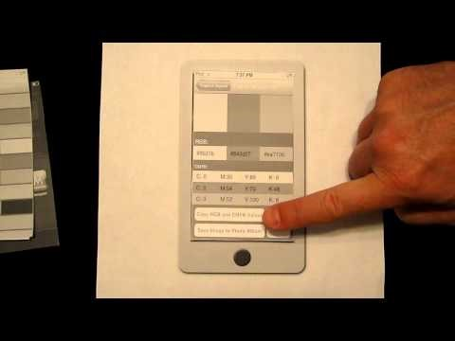
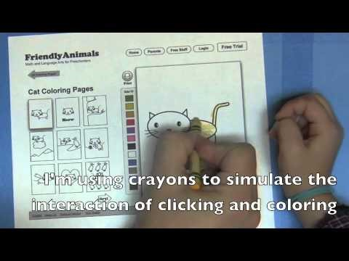

Paper Prototypes:
www.youtube.com/watch?v=V8LNDqMIapY
www.youtube.com/watch?v=9wQkLthhHKA
www.youtube.com/watch?v=GrV2SZuRPv0
www.youtube.com/watch?v=6YnKKwPyxUw

Slide 10
User-centred Design Methodology: AGILE
Prototyping
It is INTERACTIVE ?
A MODEL of the system?
Iterative Evaluation
Formative
"formalise ideas“
improving functionality / usability
typically qualitative
Expert review (your HCI specialist)
DOCUMENT!
Summative
"summary of success"
assessing the quality of a product
typically quantitative
Planned usability testing
MEASURABLE!

Slide 11
Activity 1. Requirements Analysis
Discuss/Debate/Brainstorm and identify:
  Functional requirements
  Classes of User
  (Initial assumed) User requirements
* Organisation!
* Teamwork!
* Ideas!

Slide 12
Activity 2. Prototype Interfaces
Discuss/Debate/Brainstorm and produce:
Select one class of user
Sketch initial ideas for interface designs based on their requirements (include elements from Usability and HCI: icons, validation, guidance etc.)
Create a storyboard representing functionality/usage

Slide 13
Cognitive Walkthrough: Process
The “user” acts (role-plays) as though the interface was actually built or finished.
During the CW these users work through one or more specific tasks.
Each step the user takes is scrutinized.
Look out for
  Areas where the interface blocks the user from progressing naturally and intuitively
  Convoluted and circuitous paths through function sequences

Slide 14
Cognitive Walkthrough: Process
Set up
  Anticipated users
  Users’ initial goals
  Task description
  Atomic actions in sequence
Monitor design “in use”
  Problems forming correct goals?
    Add, drop, select, choose…
  Problems identifying/performing action?
    Action/goal mismatch, physical problems, time-outs

Slide 15


Model of Interaction
…with the physical world
…in discrete stages
goals
Mental activity
evaluation
Expectations
intentions
interpretation
action specification
Choices
perception
execution
Interaction
Physical activity
(Donald Norman 1986)

Slide 16
Why?
An essential early activity is to evaluate the system from the users perspective. So you need to assess the tasks that users will perform.
It is helpful to identify the users goals and purpose for each task.
  User Class
  User Goal (Mental Model?)
  User Interaction (Feedback?)

Slide 17
When?
You will perform your Cognitive Walkthrough in front of John or Mark scheduled for:
NEXT WEEK! (check slot allocated)
Each group will have approximately 30 minutes to conduct their Cognitive Walkthrough. A specific timetable per group will follow …
Your Cognitive Walkthrough will provide you with essential experience and feedback for the assessed HCI elements of your project!

Slide 18
How?
Be well prepared so that you maximize the usefulness of this session – its your one opportunity to get a lot of expert feedback on your product.
Thoroughly prepare three task scenarios for your cognitive walkthrough.
IMPORTANT: Explain to the user/reviewer the scenario, the context, and the user role they are playing.
Avoid using minor tasks like “Login to system” – prepare substantial tasks in order to get substantial feedback!
During the session, your expert evaluator will choose 1 (or more) of your tasks to walkthrough during your time slot.
The granularity of your walkthrough is up to you but it is being assessed so judge this yourself - prepare well and give plenty of details.
Note that one long in-depth realistic task is likely to generate much more useful feedback than 3 high level minor tasks – its not about quantity but quality of feedback.

Slide 19
Task Sheets
For each of the three task scenario’s (based on you user stories and defined user roles/personas) you should create a TASK SHEET:
Each task sheet should specify:
  the task scenario name
  the task scenario description
  the user role + persona + purpose
  the user goals
  the decomposition of the task scenario into smaller predicted user sub-tasks/actions – you could use a table to display this information and use the final column of the table for comments – these will added during the execution of the walkthrough (by you!).
  * Note each member of the team (including the user) should have a copy of the task sheets.

Slide 20
Data Capture
Note-taking
Observations
Think-out-loud Protocol
Compare with Evaluation Methods from before
Ethical Considerations:
Users may feel vulnerable and it is easy to manipulate them into providing feedback in a certain way – not helpful for you!
Inform the user that all data captured/recorded will be:
  confidential
  only for use in project
  wont be uploaded or distributed
  destroyed after analysis

Slide 21
Cognitive Walkthough Criteria
  Prototype: a sufficiently-developed interface prototype (paper) to enable a useful cognitive walkthrough
  Preparation: three significant and substantial USER SCENARIO tasks were prepared for the cognitive walkthrough and documented on task sheets
  Data captured appropriately during the cognitive walkthrough (audio/hard copy data recording by multiple team members) with appropriate ethical consideration
  Professional engagement with feedback (not arguing all the time but accepting constructive feedback)
  Overall Management of cognitive walkthrough (this is your product and your experiment! – take ownership of the interaction)

Slide 22
Cognitive Walkthrough – Summary
You need to prepare 3 tasks based on USER SCENARIOS
  Document these thoroughly
  Print out the task scenario sheets! These will not be viewed online.
  The expert evaluator can choose which task(s) to walkthrough - they may do more than 1 – it is up to them!
Be prepared
  To accept lots of constructive criticism – its not a debate - do NOT argue with your evaluator/user – that’s unprofessional! But you can ask for clarification – this is a very interactive session!
  To document all your feedback – Use several team members recording data to ensure completeness and accuracy

Slide 23
What’s Next? - Usability Evaluation
There is no substitute for other users using your product.
Initially determine what you want to know about your product. These features of your product should be specific and measurable*.
* How usable is your product? is not a good objective!
Identify the users you will test.
Determine the experimental design – so how will you order and run the experiments to make the most of the test
Develop the tasks that your user will perform during each experiment. Remember to specify what constitutes a completed task.

